Slide 1




Notes:
8/22/2008 5:15 PM
1

Slide 2

Creating Great Community Games
Mitch Walker
Program Manager
XNA Community Game Platform
Microsoft

Slide 3

Why Should I Care?
You want to create a game
You want to distribute it through Xbox LIVE
Customers expectations will be high
Don’t drive away a potential customer
Goal is more people playing your game

Slide 4
Design Considerations

Slide 5
What Makes a Good Game?
Microsoft doesn’t determine what is or is not a game
…or what is fun
Most games will be played for short durations, design for this
Your game should be easy to learn
Consistent user experience is important
  The less your customer has to learn, the better

Slide 6
Game Flow
Options
Options
Help & Options
Paused
Starting
Loading
Main Menu
Playing
Exit

Slide 7
Game Flow
Starting
  Start up takes 3-5 seconds
  Common splash screen will be displayed
Loading
  Keep the time to first screen low
  Don’t ever “freeze” the screen
  Load just what you need to get the menu up
  If it takes longer than a second, display a loading screen that contains animation

Slide 8
Game Flow
Menus
  Consider “signing in” by pressing A or Start
  All menus should navigate the same
  Out of game experience is not glamorous work, but it pays off
    Use the GameStateManagement sample to start!
Playing
  That’s up to you!
Exiting
  if trial mode, display a screen that sells your game

Slide 9
Menus
Main
Single Player and Multiplayer
  If only one mode, use “Start Game”
  Consider entries for specific modes
    Timed, Puzzle, Quick Match, Co-Op, …
Help & Options
Purchase Full Game
  If in trial mode
  Use the ShowMarketPlaceOffer API
Quit

Slide 10

Menus
Main
Gamefest Demo
Single Player
Multiplayer
Help & Options
Purchase Game
Quit

Slide 11
Menus
Help & Options
How to Play
  Display brief tutorial, controls, tips
Control Options
  This is optional, but is a high value add
Audio/Video/… settings
Credits
  Give yourself some props!
For anything that can change, provide a way to reset back to defaults

Slide 12
Menus
Help & Options
Gamefest Demo
How to Play
Controls
Video
Credits
Main Menu

Slide 13

Menus
How to Play
Gamefest Demo
Move
Aim
< 1 of 3 >

Slide 14
Menus
Pause
Resume Game
Purchase Full Game
Help & Options
Save Game (Optional)
Quit
All games should have a Pause menu!
Multiplayer – pausing usually stops input, but doesn’t stop the game

Slide 15
User Experience
Use standard controls
  A for confirmation, B for cancel
  START pauses, and BACK brings up scoreboard
  Allow navigation with Left Stick and D-Pad
Provide tool tips where appropriate
These are living room games
  Design for simplicity
  Your user won’t be 20 inches away from display
Your game doesn’t need every option
Notes:
Menus and Navigation
10 foot experience
Options

Slide 16
User Experience
FAIL
Gamefest Demo
Resolution: 640 | 800 | 1280
Model Detail: Low | High
Shadow Detail: Off | Low | High
Shadow Type: Stencil | Map | VSM |
Anti-Alias: Off | 2x | 4x
Post-Processing: Off | On

Slide 17
Gamer Profiles
This is hard to get right
  But your customers will love you for it
PlayerIndex.One is not always the “right” controller
Be flexible with profile requirements
  Have fallbacks for Silver, offline, etc.
Allow profiles to sign in and out anytime
Use Gamertags, gamer pictures, etc.
Allow for viewing of other profiles

Slide 18
Technical Considerations

Slide 19
Graphics
General
Resolutions
  1280×720 is safe bet
  Consider adjusting resolution based on display settings
Scaling
  Xbox 360 will scale game to match display settings
Standard Definition
  Be sure to test text, positions on standard displays!
Color
  Check gamma and saturation
  Watch for color critical gameplay

Slide 20
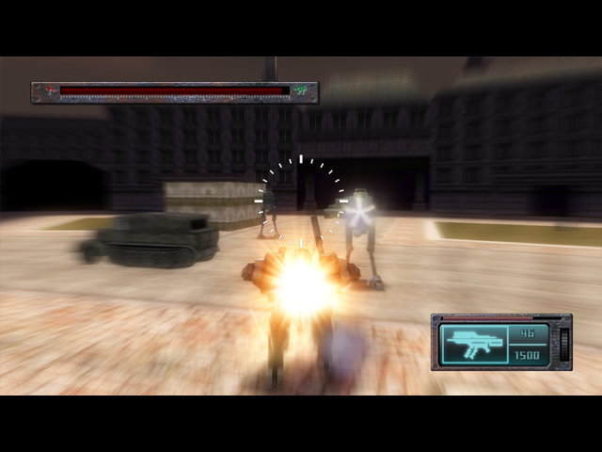
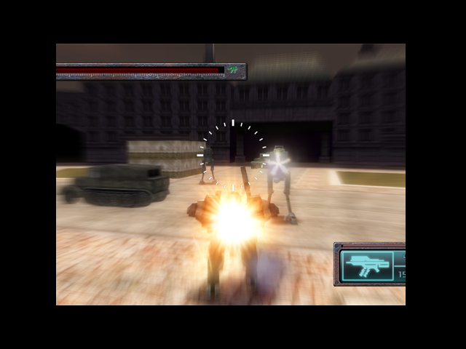
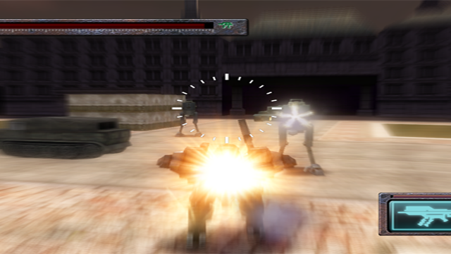
Graphics
Letterboxing
Letterboxing
  16:9 will letterbox on 4:3 displays
  But not 4:3 to 16:9
Watch out for 4:3 area
on 16:9 backbuffer on
4:3 display!
4:3 stretches on
16:9 displays
16:9 letterboxed on 4:3

Slide 21
Graphics
Safe Regions
Some displays have overscan, which can range from 0%-20%
All critical information should be in the inner 80% of the screen
Important information should be in the inner 90% of the screen
Should render to 100% of screen
Don’t try to be too clever

Slide 22
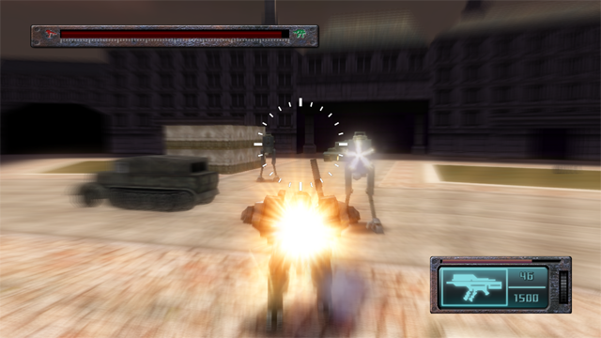


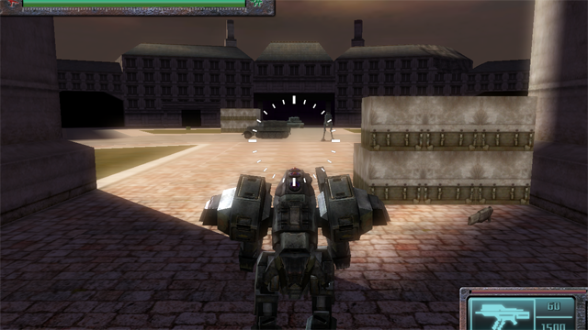
Graphics
Safe Regions
80%
90%

Slide 23
Audio
Output Levels
  Not everyone has the same audio system
  Test different speaker configurations – headphones, stereo, 5.1, etc.
Music
  Game can override current music playback
  Use Song and MediaPlayer.Play
  XACT – Set the Music Category for a Cue
Compression
  Use XMA compression!
  For music, use WMA or MP3 formats

Slide 24
Input
Make use of the controller subtypes
  Some types provide different data
Unplugged controller should pause game
Use the gamer defaults
Don’t use the keyboard

Slide 25
Storage
Treat the Storage APIs asynchronously
…because they are!
Use the correct location
  Saved games are tied to a profile
  High scores are not
IAsyncResult result = Guide.BeginShowStorageDeviceSelector(…);
while (!result.IsCompleted) { }
StorageDevice device = Guide.EndShowStorageDeviceSelector(result);

Slide 26
Multiplayer
Add a Quick Match mode
  Perform the query in the background and pick best session
Custom Match
  Specify parameters, filtering, etc
  Only 25 sessions returned
Support invites
  In process is a bit more work
Lobby
  Display match settings
  Support “ready up”

Slide 27
Multiplayer
Be sure to test, over the internet, your maximum players
Use the packet loss and latency simulation
Voice is automatic, but you may need to manage it
For larger games, consider allowing game management – kick players
See Shawn’s talk for writing performant multiplayer games!

Slide 28
Content Size
Games have a 150 MB size limit
All content is compressed by default
Audio compression
  Use it - XMA on the Xbox 360 is quite good
Texture compression
  Use DXT if you can – it often depends on the type of textures
Texture density
  You don’t always need that 2048×2048 crate texture

Slide 29
Content Loading
For small games, load all content at start up
JIT loading of content is tricky
  Getting it wrong results in hitching or content “popping”
Use a ContentManager per “zone” of content
Unloading Content
  Disposing a ContentManager is the best way
  Create custom ContentManager to provide more fine grained control

Slide 30
Testing
Submitting a release is “real”
Thorough testing is important
Be sure to have your peers help test your game before submitting
Considerations
  Different displays and video modes
  Gold, Silver, Offline profiles, both signed in and signed out
  Multiple storage devices
  Multiplayer over the Internet

Slide 31
Selling Your Game
Game metadata
  Title, Description
  Genre
  Game Capabilities
  Thumbnail, Box art, Screenshots
Trial mode
  Time limited sessions
  Showcase your game inside that time
  Enable customer purchase while game is running

Slide 32
Next Steps
Create Your Game
Get started using XNA Game Studio 2.0
Participate in the community beta!
Visit http://creators.xna.com
  Game Best Practices (Soon!)
  Samples, Tutorials, Videos
  Active Forums

Slide 33

www.xnagamefest.com
© 2008 Microsoft Corporation. All rights reserved.
This presentation is for informational purposes only.
Microsoft makes no warranties, express or implied, in this summary.

